Slide 1

Presentation On
E-commerce Analysis
By-Group -3
Ramadugu AnanthaLakshmi
Reshma Gouda
Vaishnavi Deshmukh
Deepak kumar
Tamal Singha Roy
B Rishikesh

Slide 2
INDEX
Introduction
Data Understanding
Data Cleaning & Preparation
Exploratory Data Analysis
KPI Development
Customer & Seller Analysis
Data Visualization (Tableau/Power BI/Excel)
Insights & Recommendations
Conclusion

Slide 3
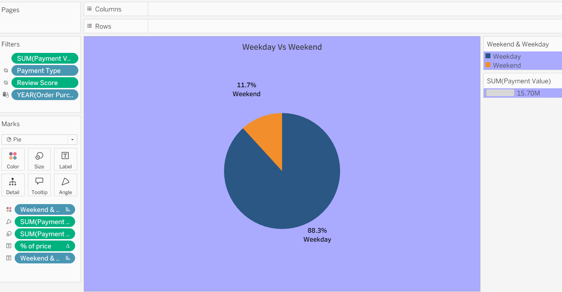
KPI-1
Most of the purchases (88.3%) happen on weekdays, while only 11.7% occur on weekends. This shows customers are more active during weekdays, so promotions and campaigns should be focused on weekdays, with special offers to boost weekend sales.

Slide 4
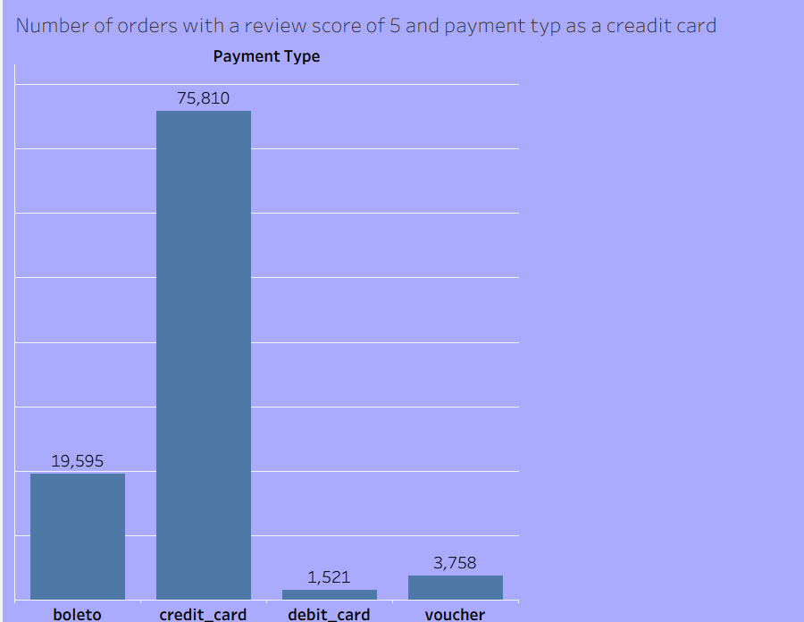
KPI-2
Most 5-star reviews come from credit card payments (75,810 orders), showing it is the most preferred and reliable payment method. Other modes like boleto (19,595), debit card (1,521), and voucher (3,758) have much lower counts.
Credit card dominates customer satisfaction with the highest number of 5-star reviews.

Slide 5
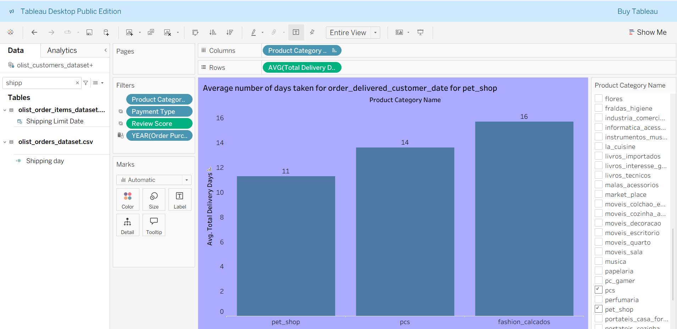
KPI-3
This chart shows the average number of days taken for delivery across selected product categories.
Pet Shop products take the least time, around 11 days on average.
PCS items take about 14 days.
Fashion/Calçados products take the longest, around 16 days.
This indicates that delivery speed varies by category, with pet shop items being delivered faster, while fashion items face longer delivery timelines.

Slide 6
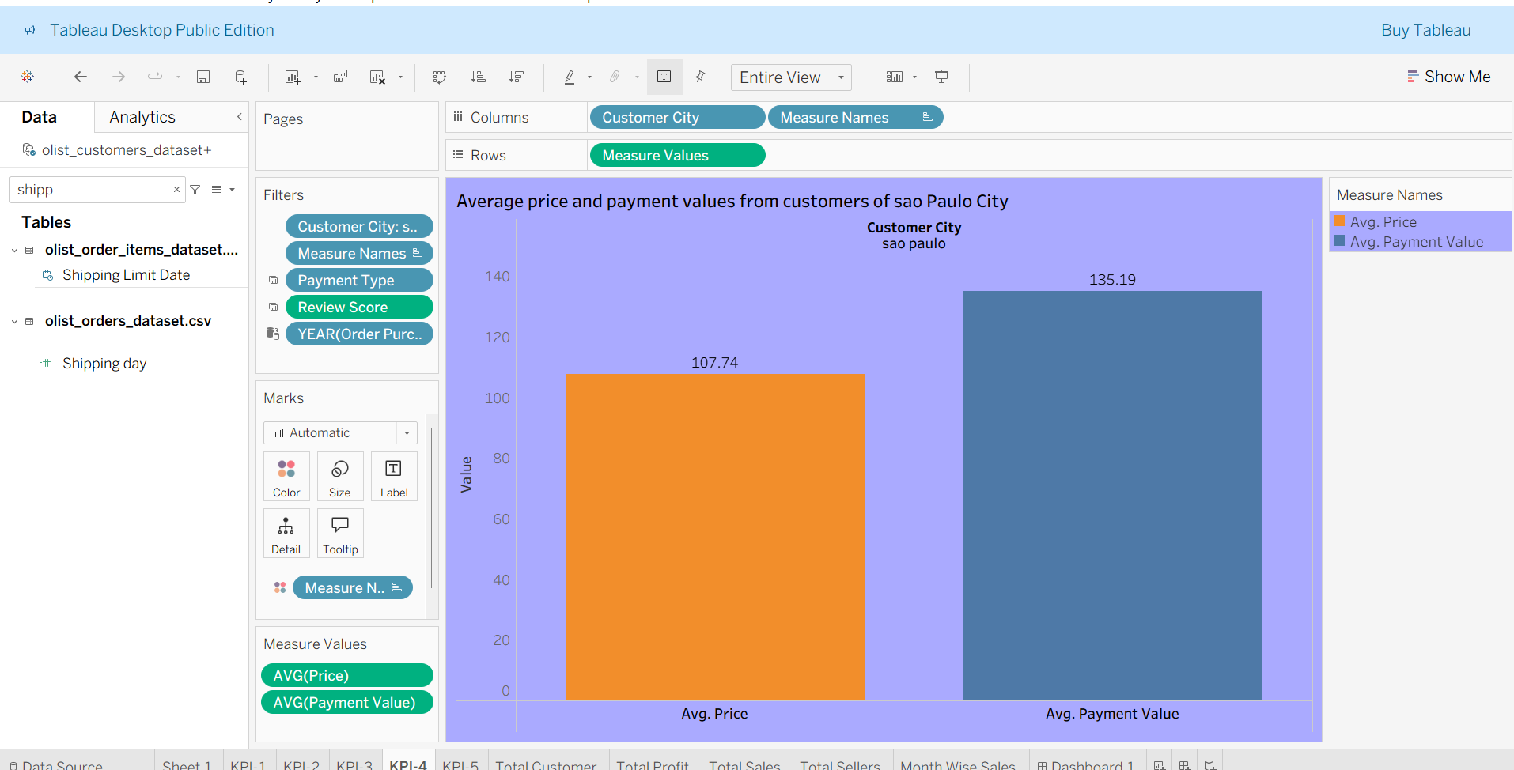
KPI-4
This chart shows the average price and payment values for customers from São Paulo City.
The average product price is 107.74.
The average payment value is higher at 135.19.
This indicates that customers in São Paulo tend to pay more than the base price, possibly due to shipping costs, installment charges, or additional fees.

Slide 7
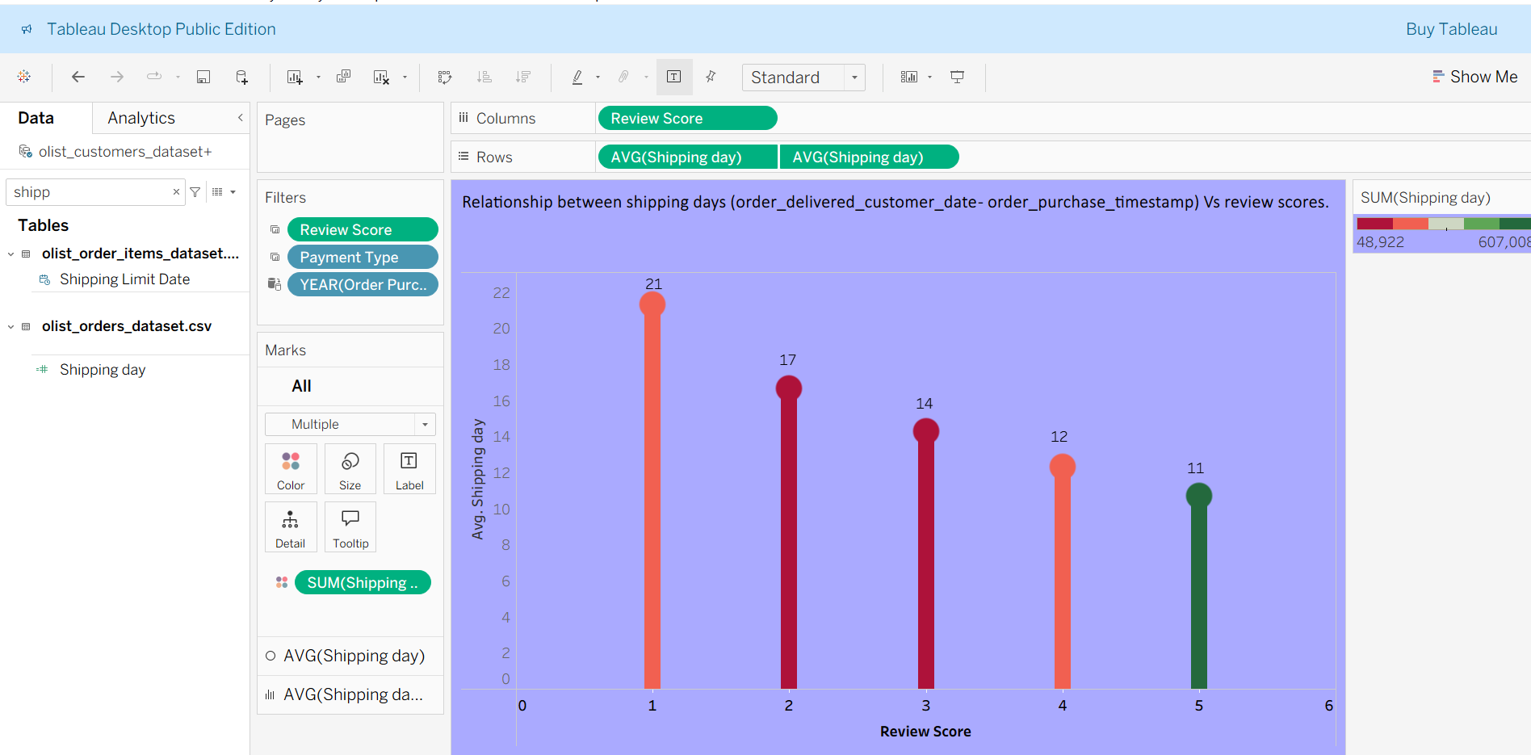
KPI-5
This chart shows the relationship between shipping days and review scores.
Lower review scores (1 & 2) are linked with longer delivery times (21 and 17 days).
Higher review scores (4 & 5) are linked with faster deliveries (12 and 11 days).
Insight: Faster delivery leads to better customer satisfaction and higher review scores.

Slide 8
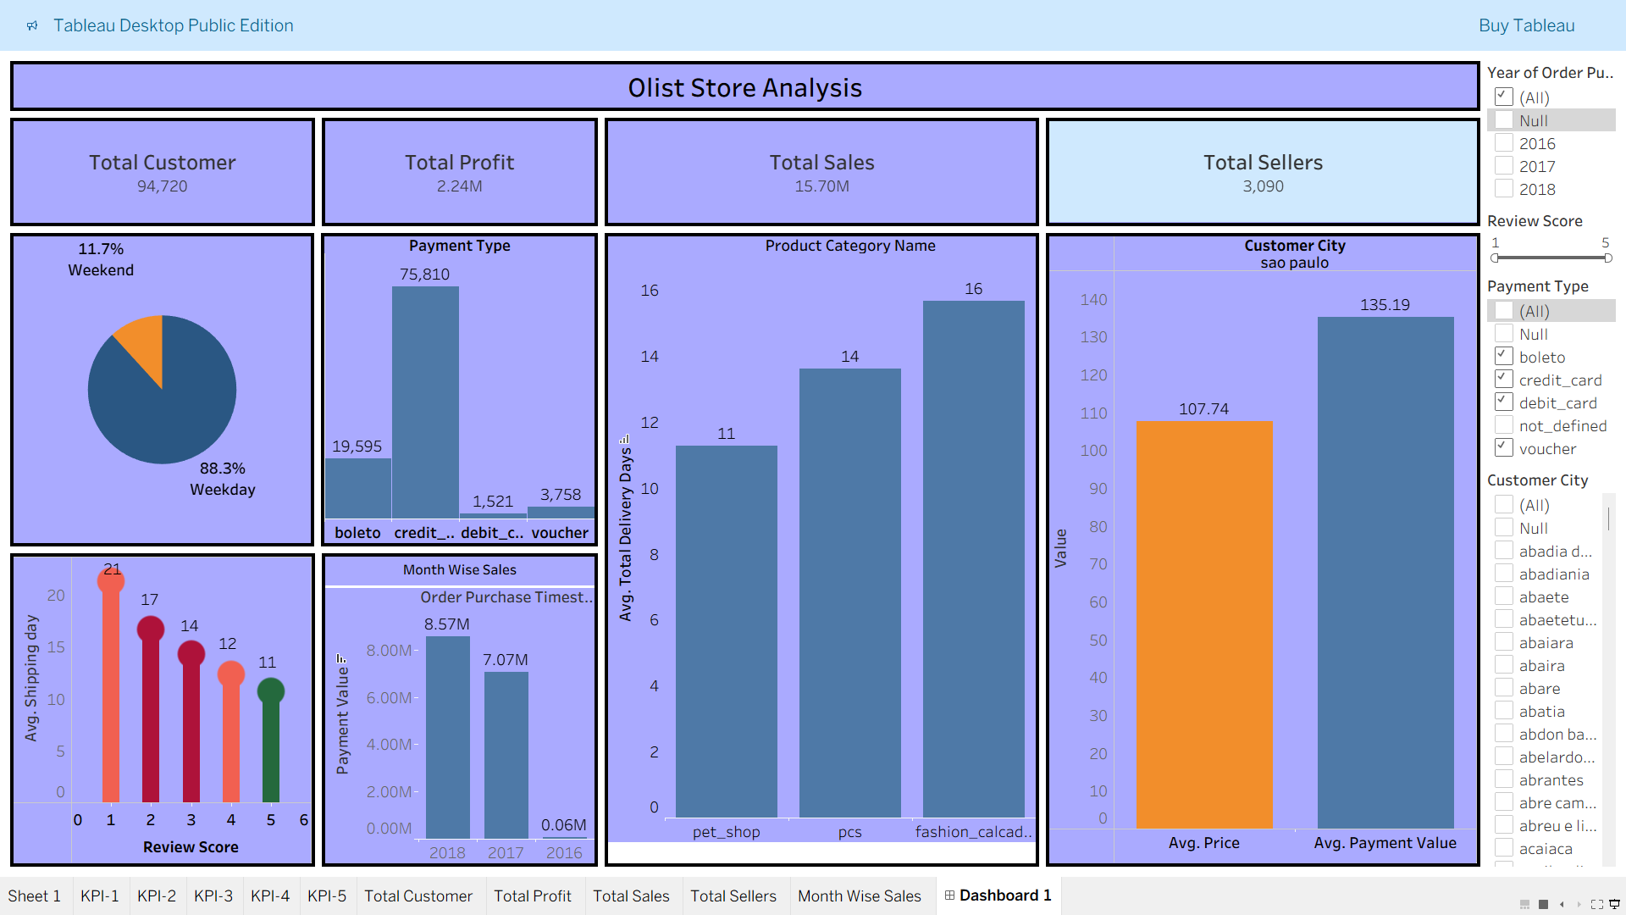
TABLEAU DASHBOARD

Slide 9
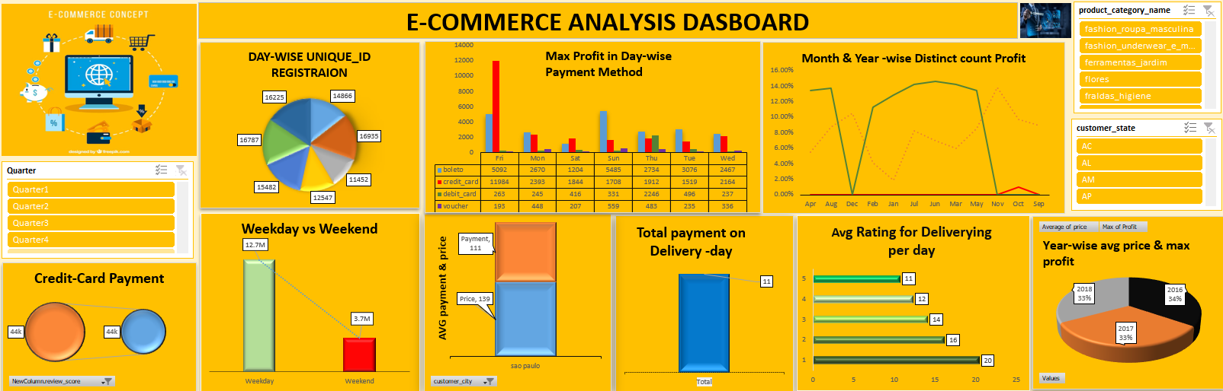
EXCEL DASHBOARD

Slide 10
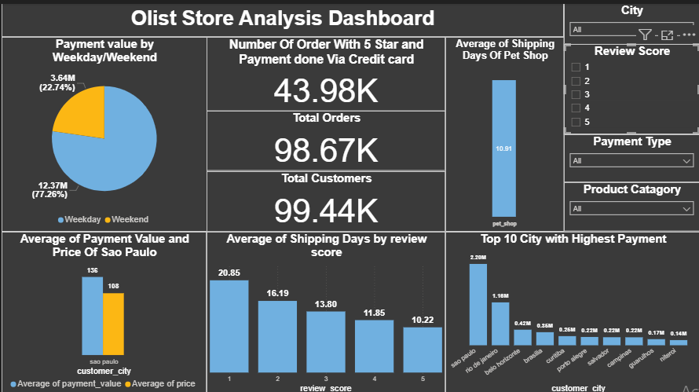
POWERBI DASHBOARD

Slide 11
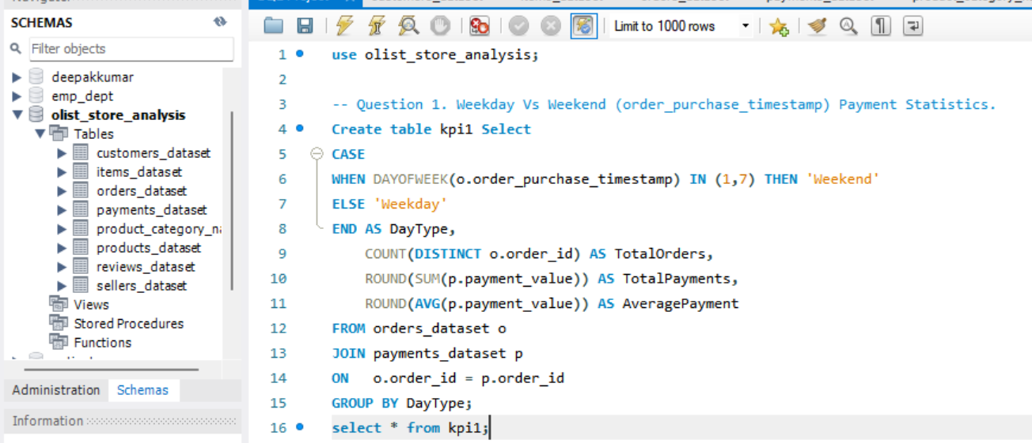
SQL QUERY

Slide 12
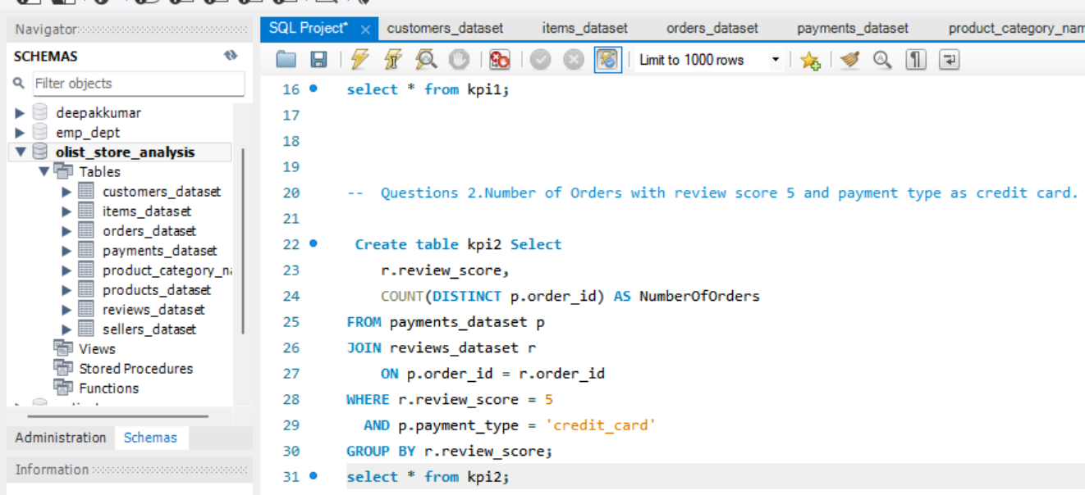
SQL QUERY

Slide 13
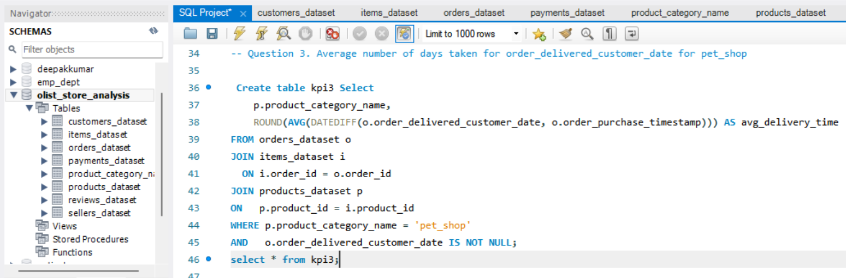
SQL QUERY

Slide 14
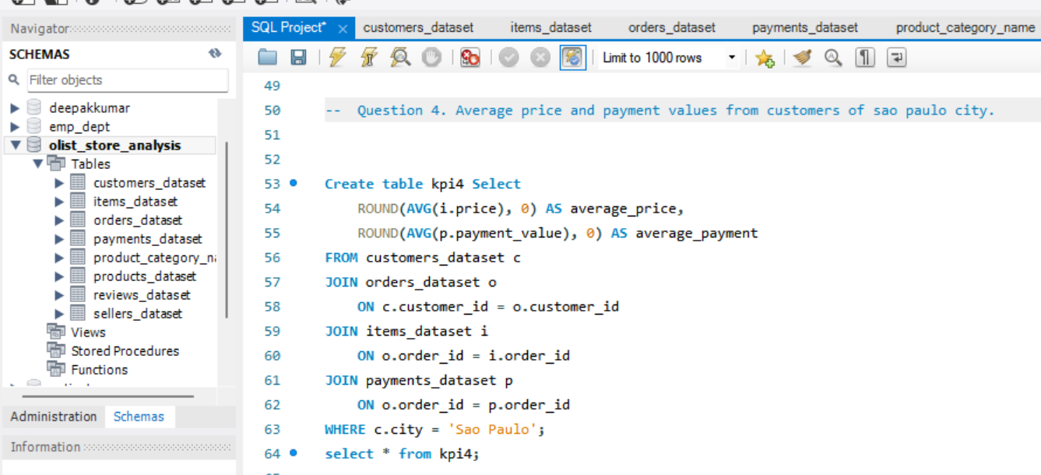
SQL QUERY

Slide 15
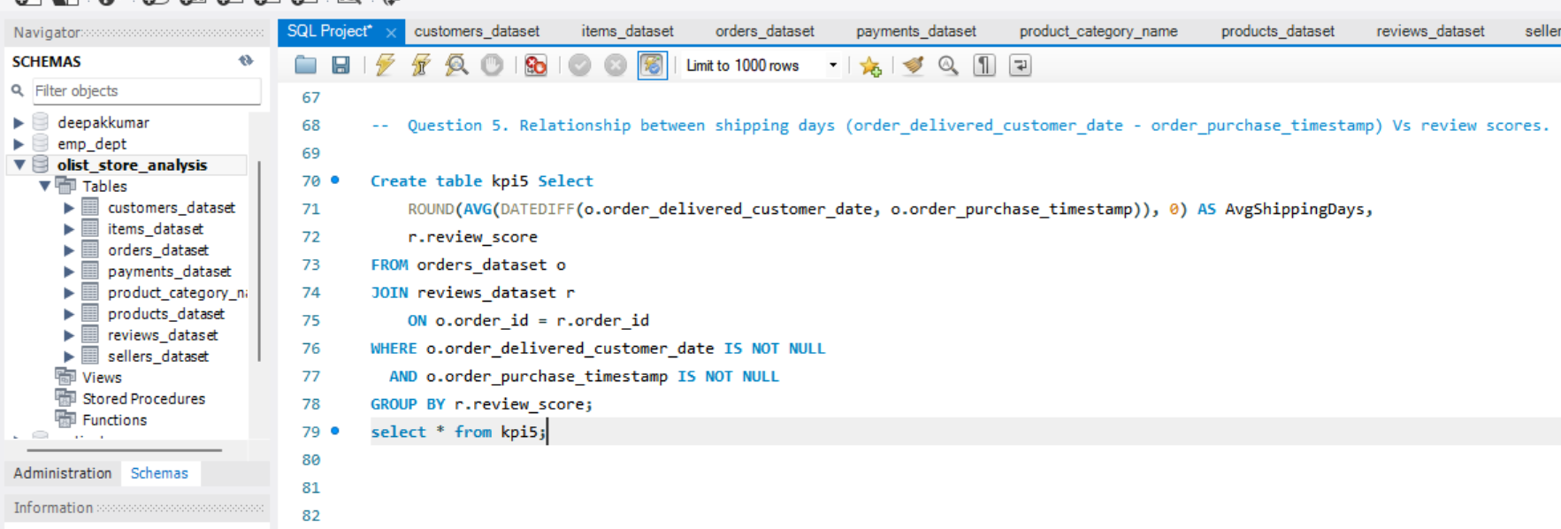
SQL QUERY

Slide 16
CONCLUSION
Overall, this project helped me understand how to handle real-world e-commerce data. I faced many challenges during the process, like cleaning messy data, linking different tables correctly, and choosing the right visuals to show insights clearly.
But through these challenges, I learned how to use tools like Tableau, Power BI, and Excel more effectively.
In the end, I was able to create a dashboard that gives a clear view of sales performance, customer behavior, and key business trends. This project really improved my data analysis and visualization skills, and helped me learn how to turn data into meaningful insights.

Slide 17
CHALLENGES FACES
Data Collection & Cleaning
Raw data from multiple sources (orders, payments, reviews) was inconsistent and incomplete.
Example: Missing order dates, duplicate entries, or mismatched customer IDs.
Data Transformation
Different date and currency formats caused issues in analysis.
Example: Converting timestamps to standard date formats (like YYYY-MM-DD)
Data Transformation
Different date and currency formats caused issues in analysis.
Example: Converting timestamps to standard date formats (like YYYY-MM-DD)
Visualization Design
Choosing the right charts for KPIs (Sales Trend, Top Categories, Payment Type, etc.).
Example: Too many visuals made the dashboard cluttered.
Performance Optimization
Dashboard became slow due to large dataset.

Slide 18
THANK YOU…

